Slide 1
Year 10 Online Literacy and Numeracy Assessment Mark Downsborough
Dean of Administration

Slide 2
Background information
Online Literacy and Numeracy Assessment (OLNA)
2013 - Feedback from employers and training providers about the low literacy and numeracy capabilities of some school leavers
2016 – minimum standard of literacy and numeracy required to achieve a Western Australian Certificate of Education (WACE)

Slide 3
Background information
Online Literacy and Numeracy Assessment (OLNA)
To successfully meet the literacy and numeracy requirement, students must demonstrate the skills regarded as essential to meet the demands of everyday life and work in a knowledge-based economy. These skills are described in Level 3 of the Australian Core Skills Framework
Further information can be found at
https://senior-secondary.scsa.wa.edu.au/assessment/olna

Slide 4
Prequalification from NAPLAN
https://senior-secondary.scsa.wa.edu.au/assessment/olna/prequalification-through-naplan

Slide 5
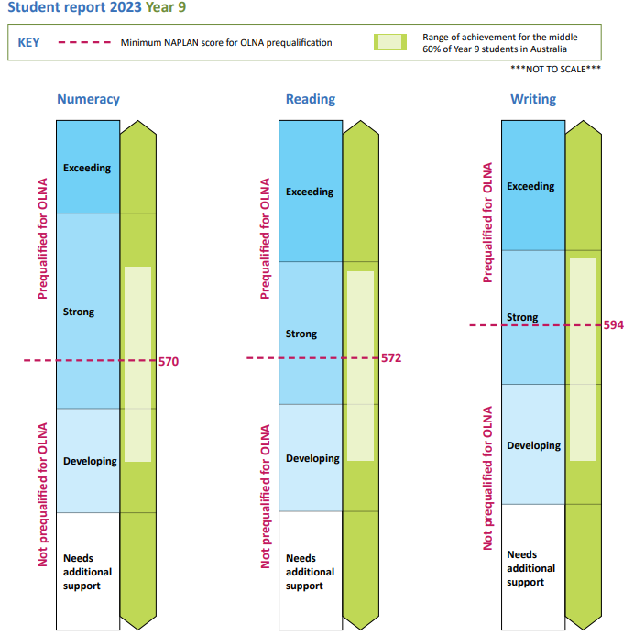
Illustration of NAPLAN scores for OLNA prequalification

Slide 6
OLNA Assessments Details
The OLNA is comprised of three different assessments
Literacy – Reading : 45 Multiple Choice Questions – 50 minutes
Literacy – Writing : 600 word typed response – 60 minutes
Numeracy : 45 Multiple Choice Questions – 50 minutes
Students will be given login and password details as they enter the assessment room

Slide 7
Testing Windows
Year 10 OLNA assessments will be conducted:
Term 2 : 22nd April to 3rd May
Term 3 : 2nd to 13th September
A catch up session for students who have not had two opportunities will be arranged in October
More detailed schedules will come out closer to the dates

Slide 8
Who has to sit the assessments?
All year 10 students are required to sit the assessments. Some are given exemptions due to achieving the required score in NAPLAN.
Each student will receive an ‘Information for Students’ letter detailing when and where they should go to sit the assessment
Notes:
Paul cue

Slide 9
Practice & Example OLNA
Students will be given an opportunity in class before the assessments, if not already, to try a practice OLNA test during class time.
SCSA has broadened the scope of these practice tests to include two full example assessment of each of the components.

Slide 10
Students can access these at home, details will be on their OLNA information sheets.
https://assess.scsa.wa.edu.au
Login : 1366
Password : prac14

Slide 11
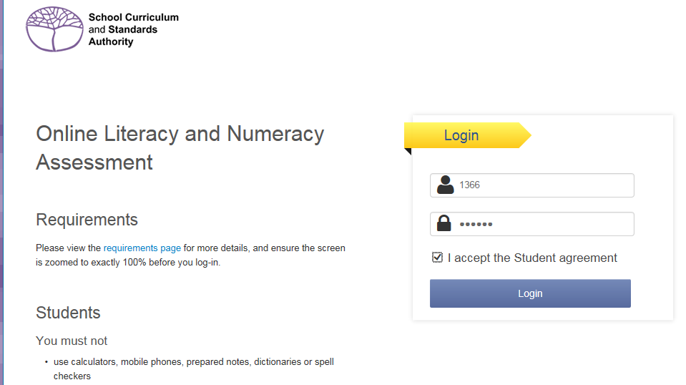

Slide 12
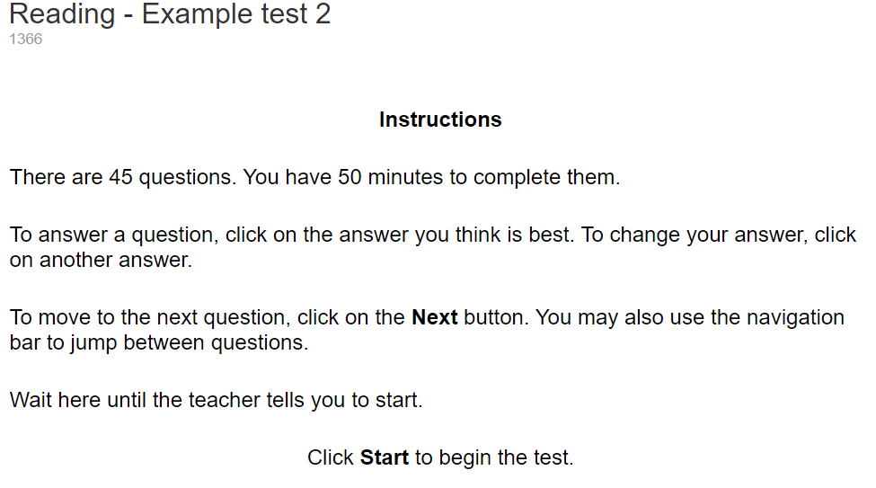

Slide 16
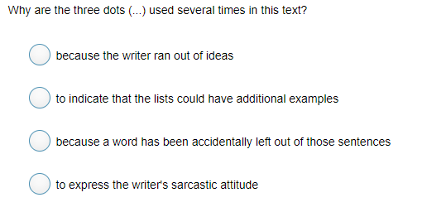

Slide 17
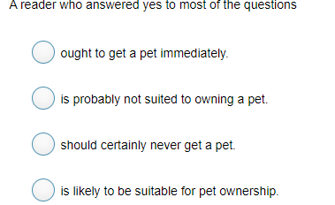

Slide 18
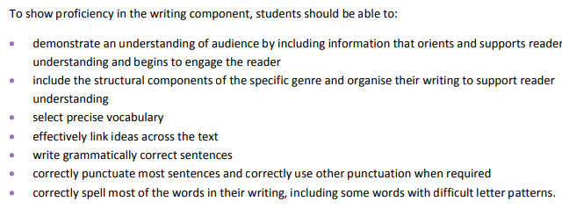
Writing Assessment

Slide 19
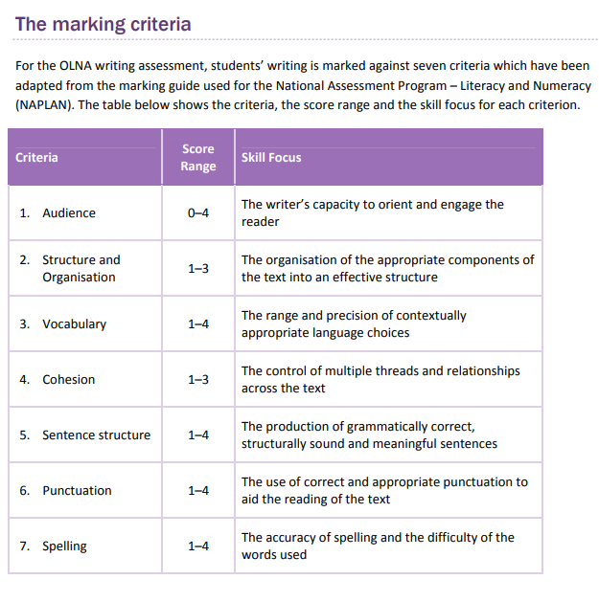
Writing Assessment

